Slide 1
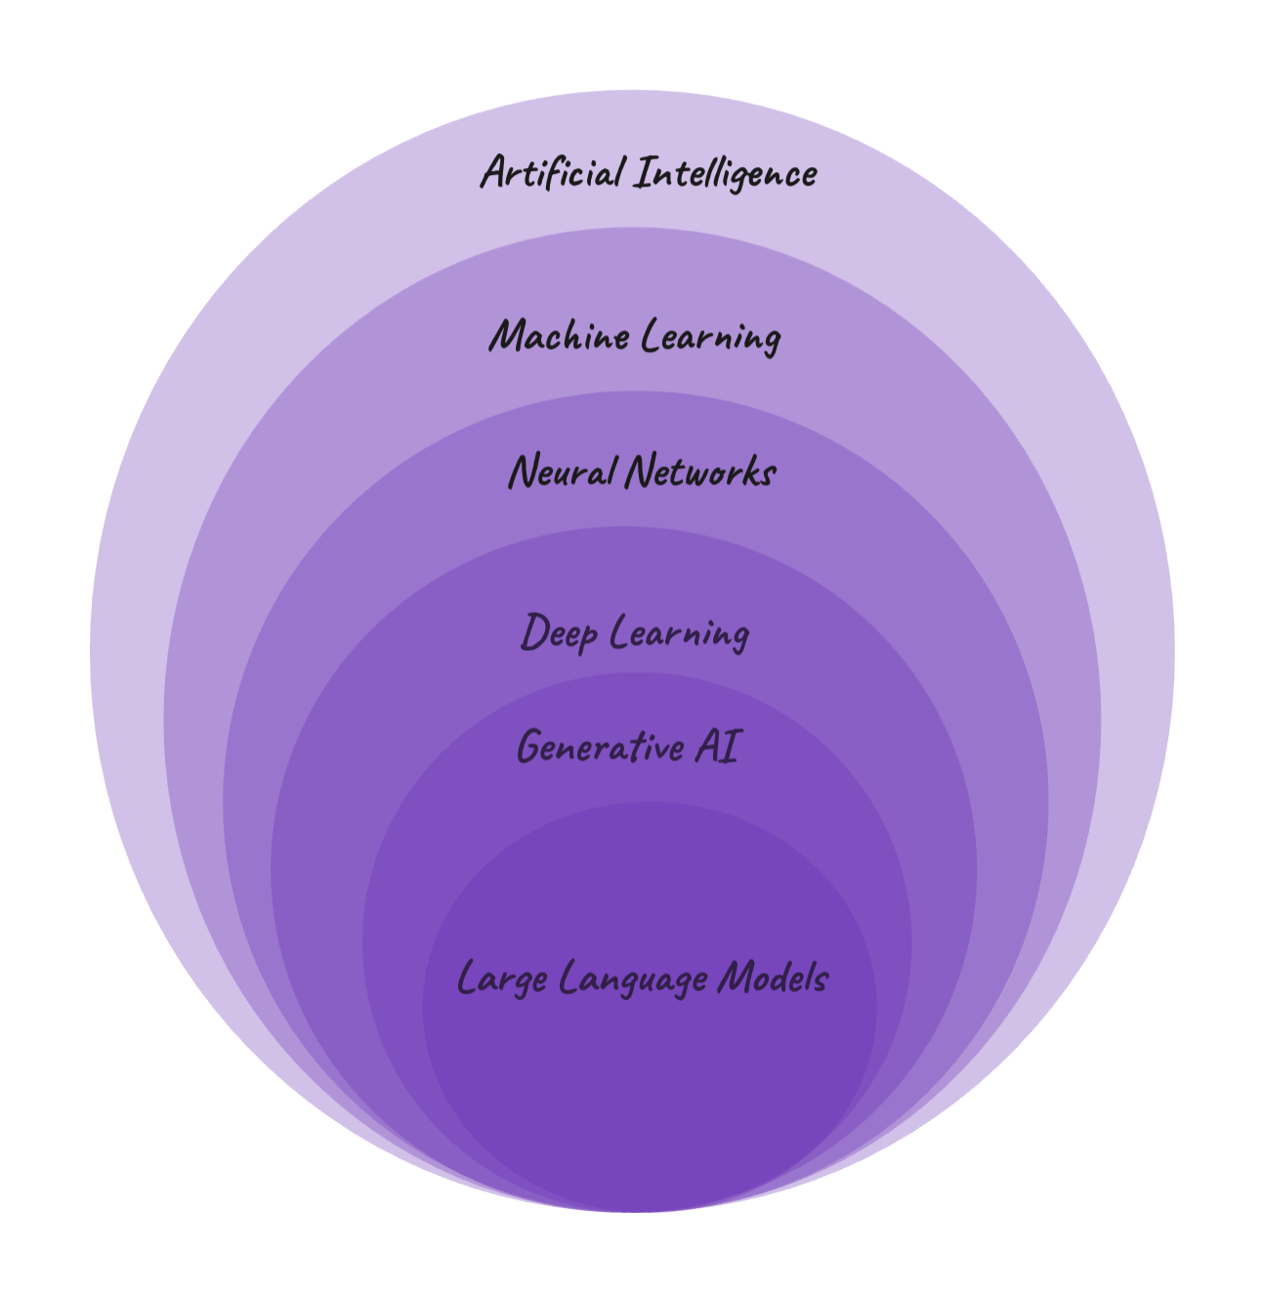
The Tale of LLMs
By Assala Benmalek

Slide 2
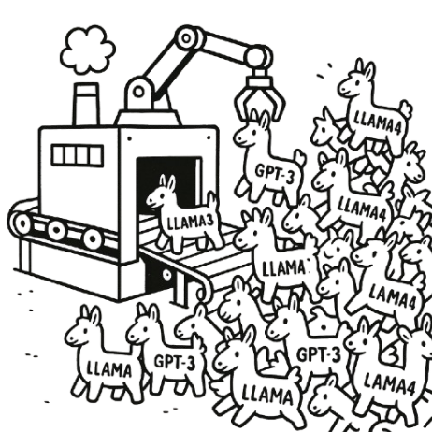

There are more than 1.5 million open-source
LLMs available for end users on Hugging Face!

Slide 3
But how did we come to have so many LLMs?

Slide 4

Once upon a time ... in 2017
Google research scientists published their paper in machine translation which its new architecture that was later a game changer in the NLP field!

Slide 5

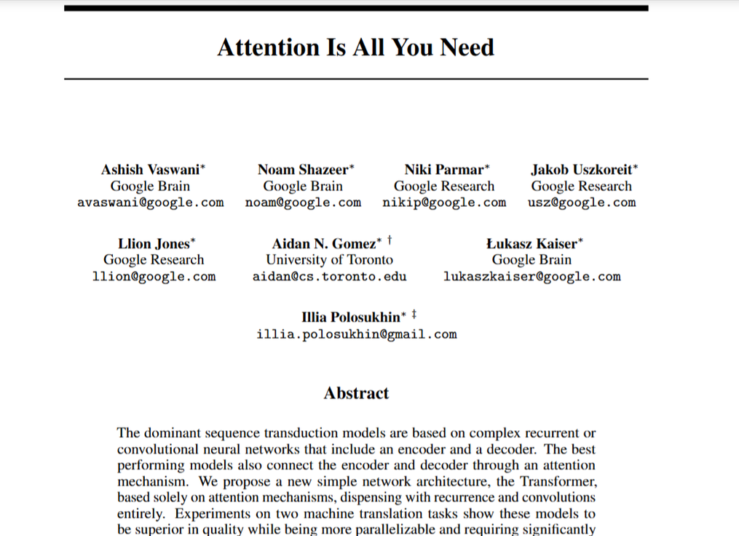
Transformer Architecture
Decoder
Introduced in the paper : Attention is all you need
Encoder

Slide 6

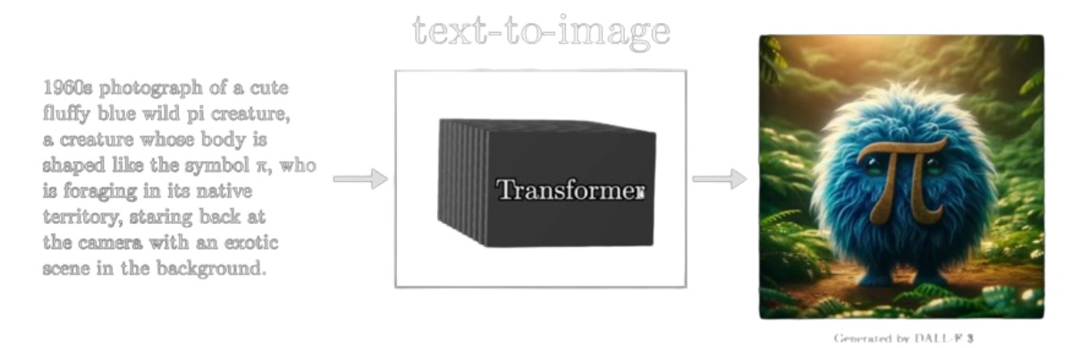
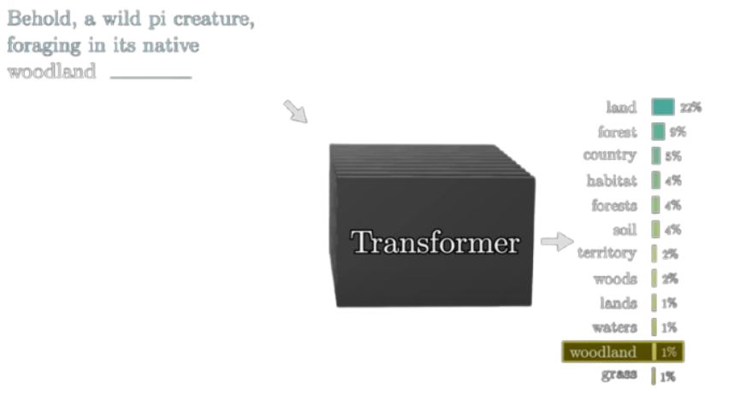
Transformers Applications
Machine Translation
Text-to-image Generation
Text Generation

Slide 7


"Large language models work based on a probability distribution of predicting the next token in a sequence given an input context."

Slide 8
Transformer Architecture for LLMs
Encoder
Decoder
Encoder - Decoder Architecture

Slide 9
Transformer Architecture for LLMs
Encoder
Encoder only Architecture

Slide 10
Transformer Architecture for LLMs
Decoder only Architecture
Decoder

Slide 11
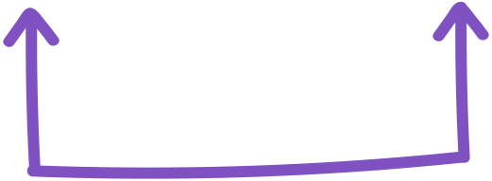



How LLMs work?
Tell me a joke .
Input Sequence
token1
token2
token3
token4
1
2
3
4
Positional encoding
Tokanization:
0.56
0.43
5.4
3.22
7.5
0.46
0.73
6.4
3.5
2.1
0.16
0.30
2.1
7.2
2.5
0.08
4,33
0.04
2.12
0.5
Token embedding
Question: how can it know the position of the words?

Slide 12


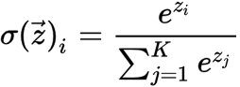
0.56
0.43
5.4
3.22
7.5
0.46
0.73
6.4
3.5
2.1
0.16
0.30
2.1
7.2
2.5
0.08
4,33
0.04
2.12
0.5
0.1
0.1
0.1
0.1
0.6
Embeddings
Output
Attention layer
0.56
0.43
5.4
3.22
7.5
Multilayer perceptron
Attention layer
Linear + softmax layers
0.56
0.43
5.4
3.22
7.5
0.56
0.43
5.4
3.22
7.5
Multilayer perceptron
0.56
0.43
5.4
3.22
7.5
0.16
0.30
2.1
7.2
2.5
0.08
4,33
0.04
2.12
0.5
...... repeatition x N
y=Wx+b

Slide 13




LLMs families
GPT
Llama
Granite
Mistral
OpenAI
Meta
IBM
Mistral AI

Slide 14
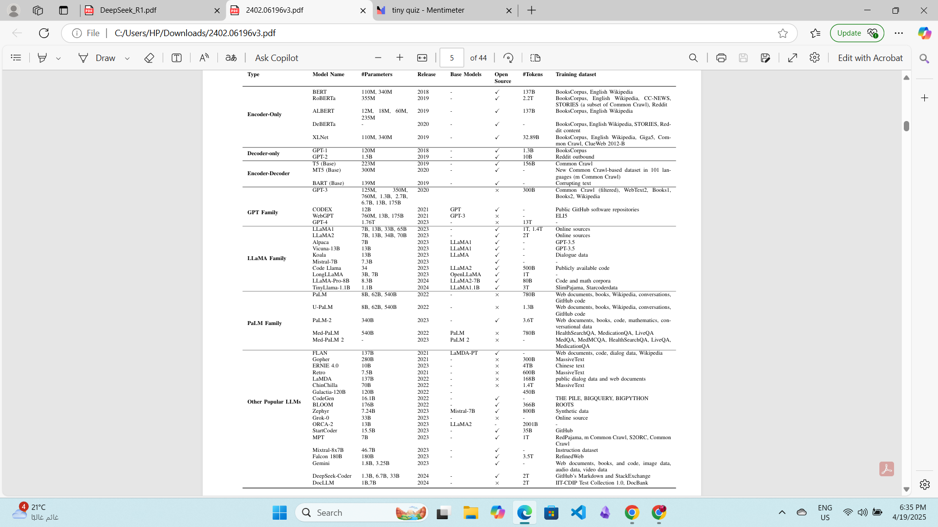

Slide 15
LLM training
LLMs are initially trained on a large number of random text datasets
And each training process can be both time-consuming and expensive in terms of resources.
Fine-tuning
Instruction tuning
Prompt engineering
Example: Llama3 VS Llama3-Instruct

Slide 16

LLMs Alignment
AI Alignment is the process of steering AI systems towards human goals, preferences, and principles.
Goal: To avoid hallucination and harmful content generation.

Slide 17
LLMs Alignment
Reinforcement Learning
DPO
Direct Preference Optimization (DPO)
Directly optimizing model outputs to match human preferences using a loss function derived from preference data.
RLHF: using Human feedback
RLAIF: using AI feedback
Reward the model approach

Slide 18

What’s Next ?

Slide 19

LLMs Applications
AI Agents based on LLMs
Copilots
AI assistants
Code
Healthcare
Legal instructions
Finance

Slide 20
Are we approaching peak LLM development, or is this just the beginning?

Slide 21
Thank you for your attention :)

Slide 22
Resources
3Blue 1brown : https://www.youtube.com/@3blue1brown
attention is all you need paper: https://arxiv.org/pdf/1706.03762
Large Language Models: A Survey : https://arxiv.org/pdf/2402.06196

